Slide 1
Instructions
Follow the learner instructions in the grey text boxes for each slide.
Delete the text box and instructions when complete.
Instructions for learner:
Action 1
Action 2
Action 3

Slide 2


Build a Personalized Online Course Recommender System with Machine Learning
Michael M
12/12/2022

Slide 3

Outline
Introduction and Background
Exploratory Data Analysis
Content-based Recommender System using Unsupervised Learning
Collaborative-filtering based Recommender System using Supervised learning
Conclusion
Appendix

Slide 4
Introduction
Massive Open Online Courses (MOOC) allow learners to affordably study nearly any subject on their own schedule from the comfort of their home.
The convenience of these courses, and the rising cost of academic institutions have prompted huge demand for MOOCs across all domains.
MOOC platforms have responded to the demand by offering myriad courses in their catalogs.
Vast course catalogs mean users are unable to efficiently browse through the offerings; potentially missing courses they would be interested in taking.
Recommender systems can be trained on user profile and course genre data to provide users with recommendations tailored to their interests.
These systems can be engineered to promote content that is likely to be missed by traditional catalog browsing.

Slide 5
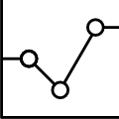
Exploratory Data Analysis

Slide 6
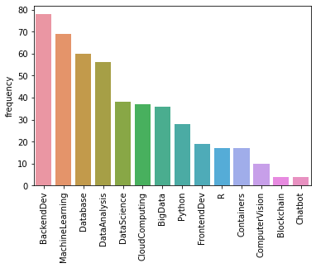
Course counts per genre
Notes:
The dataset consists of data science and software development courses. The above bar chart show the distribution of genres in the course data set. Note that courses may be tagged with more than one genre.

Slide 7
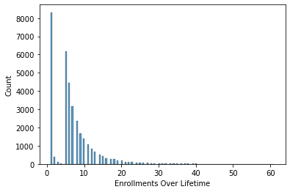
Course enrollment distribution
Notes:
This histogram stratifies user data based on the number of courses enrolled in. The majority of users have only enrolled in a single course. A few dedicated users have enrolled in ~40 courses.
This may suggest that users sign up for the website with one particular course in mind. Customer retention may hinge on providing quality recommendations while users are still enrolled in course one.

Slide 8
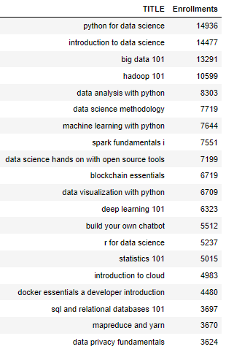
20 most popular courses
Notes:
The 20 most popular courses in the dataset are shown above.
Note the introductory courses are the most popular. Why does interest in the advanced courses tail off?
This question could lead to a metric to evaluate the recommender system once it is deployed.
Profile data that contains the order each user took their courses could be used to train a system to recommend courses in a logical order.

Slide 9
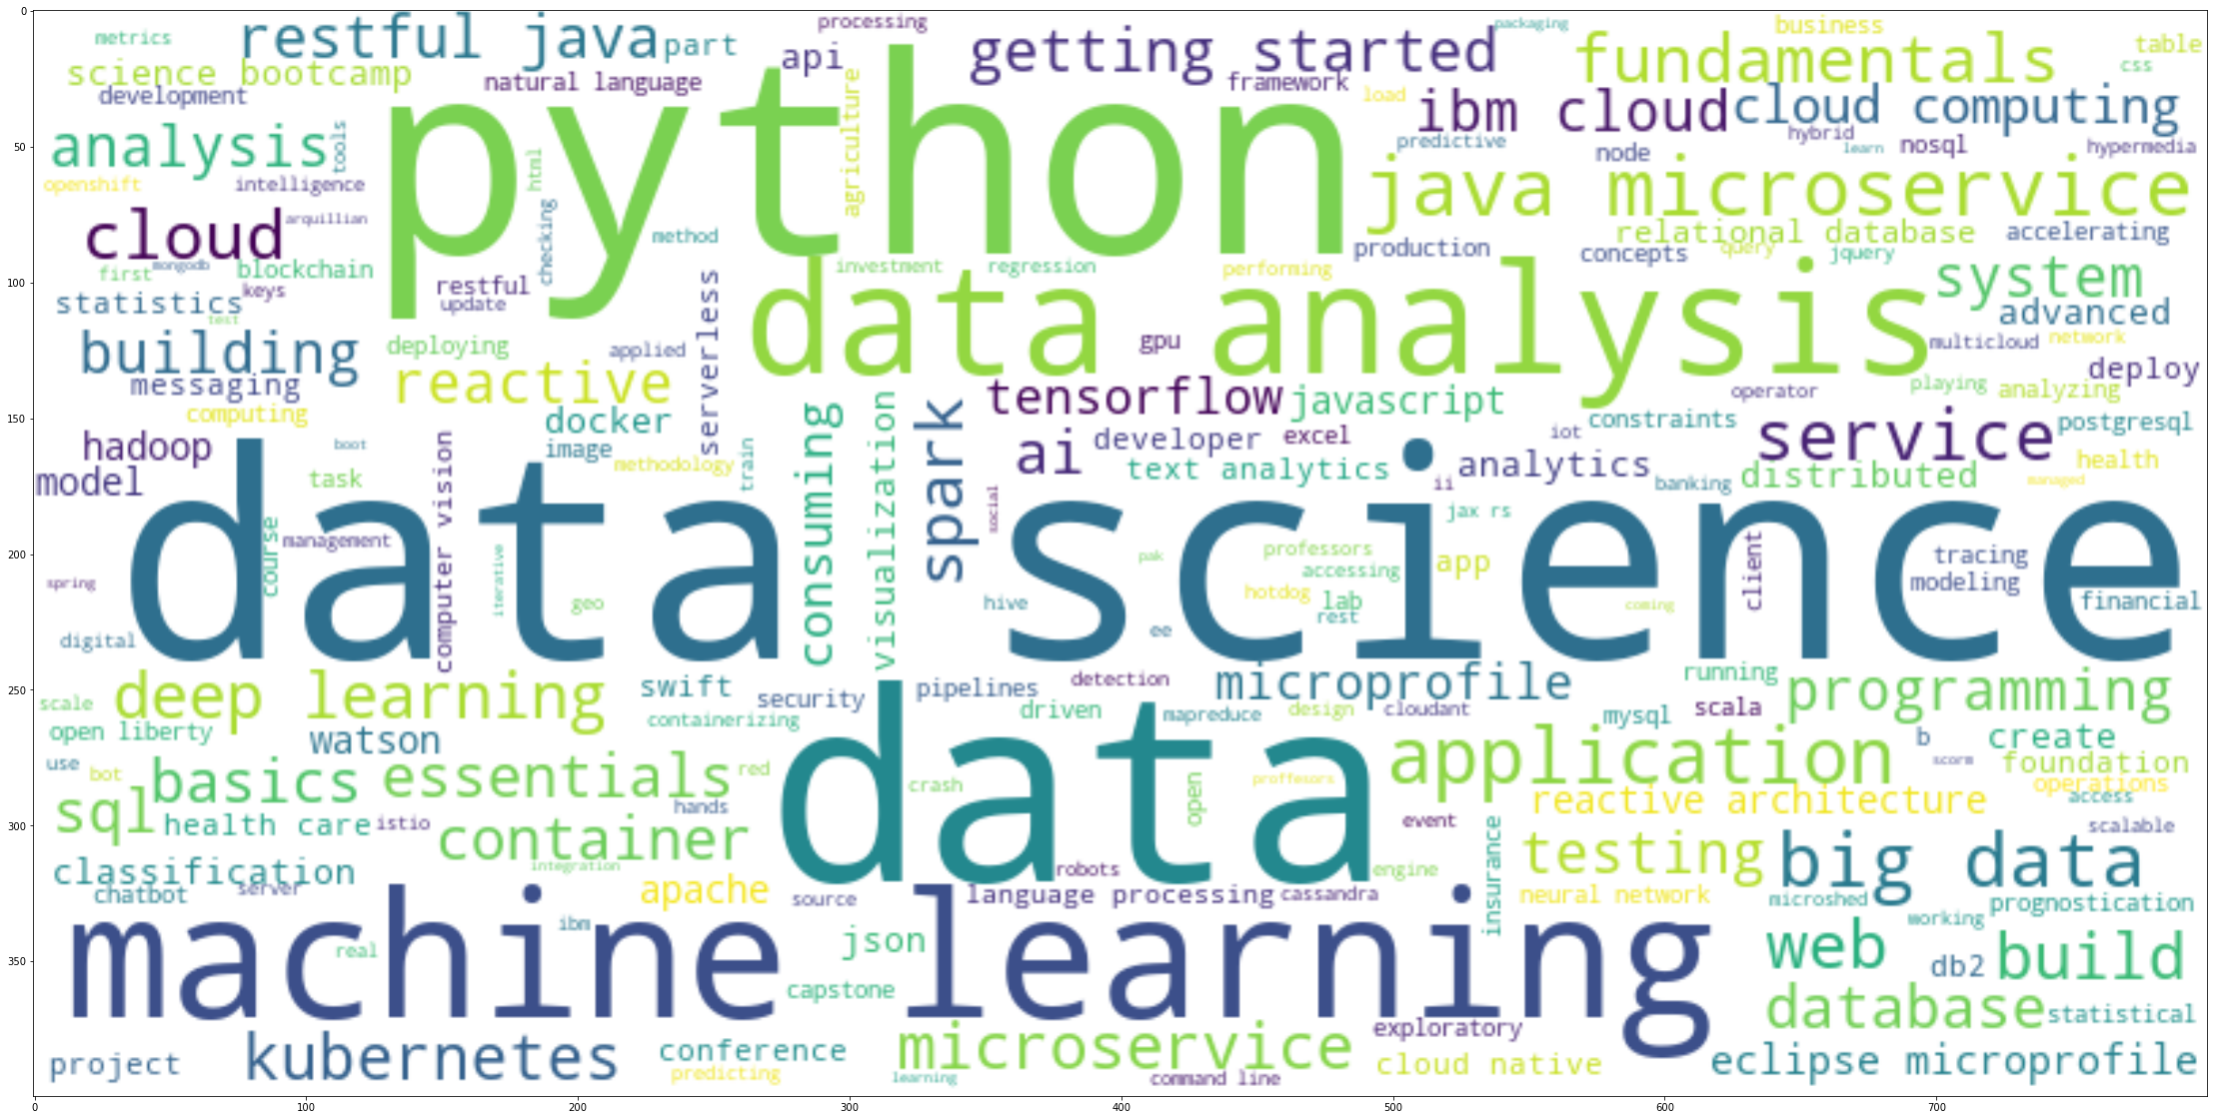
Word cloud of course titles
Notes:
This word cloud shows which words appear most frequently in the course titles and descriptions. The larger the text, the more frequent the word appears in the dataset.

Slide 10
Content-based Recommender System using Unsupervised Learning
Cluster2
Cluster1

Slide 11
Flowchart of content-based recommender system using user profile and course genres
User Profile Data
Dot Product
Similarity Score
Similarity Threshold
Recommendation
Course Genre Data
Notes:
There are two data sets used for this analysis: User profile data and course genre data.
User profile vectors contain the genres of interest to the users. The higher the score, the more courses the user has taken in that genre.
Each course has been tagged with its genres.
Dotting the user profile vector with the course genre vector yields a similarity score.
Recommendations are based on a score threshold hyperparameter.

Slide 12
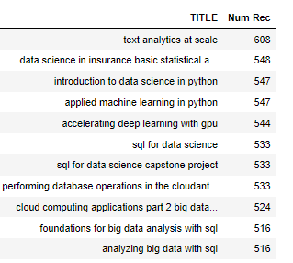
Evaluation results of user profile-based recommender system
Score Threshold = 10
On average, 62 courses are recommended to each user.
This may indicate that the score threshold is too low.
Top 10 most recommended courses:

Slide 13
Flowchart of content-based recommender system using course similarity
Course Similarity Score (BOW)
User-Item Rating Data
User Enrolled and Unseen Courses
Compare Enrolled/Unseen Courses
Score Threshold
Recommendation
Notes:
This method looks at the courses a user is enrolled in and recommends courses that have similar scores from a bag of words (BOW) analysis.
The similarity scores were provided by IBM. Assume that BOW scores include course title and course description.
Partition data into enrolled courses and unseen courses for each user.
Loop through the unseen courses for each user and compare each course to all enrolled courses for the user. Save the highest similarity score for each unseen course.
Recommend all unseen courses above a threshold.

Slide 14
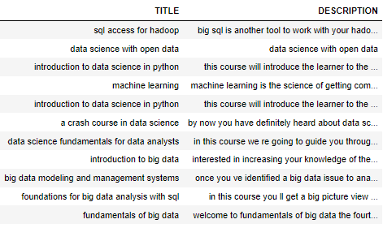
Evaluation results of course similarity based recommender system
Similarity Threshold = 0.6
On average, 12 courses are recommended to each user.
12 is a manageable number of recommendations from a user perspective.
Top 10 most recommended courses:

Slide 15
Flowchart of clustering-based recommender system
User Profile Data
Tune Hyperparameters: n_clust & fit kmeans to profile data.
Label User data with clusters.
Determine set of courses for each cluster.
Sort users by clusters.
User-Item Rating Data
Generate course list for each cluster.
Recommend unseen courses in each cluster for each user.
Notes:
Use kmeans to cluster scaled profile data.
Select a number of clusters then fit a kmeans model on profile data.
Label each user in the user-item-rating matrix with the predicted cluster number.
To recommend to a user, filter data to specific cluster number.
Wrangle the courses enrolled by all users in that cluster.
Filter out the courses the user is enrolled in.
Recommend the remaining courses. Priority can be given based on the number of times the course was enrolled in in that cluster.

Slide 16
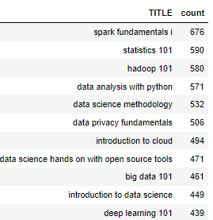
Evaluation results of clustering-based recommender system
18 clusters – determined from elbow graph.
On average, 13 courses are recommended to each user.
Top 10 most recommended courses:

Slide 17
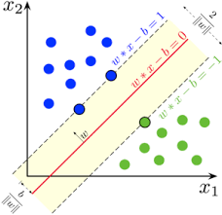
Collaborative-filtering Recommender System using Supervised Learning

Slide 18
Flowchart of KNN based recommender system
Tune Hyperparameters:
User Based/Item Based
Similarity Metric
k/min_k
User-Item Rating Data
Generate Similarity Matrix
Fit KNN on Sparse User-Item-Rating Data
Predict ratings for users.
Recommend Courses Above a Rating Threshold
Notes:
User-Item-Rating Matrix
Specify Hyperparameters
User based or Item based.
Similarity metric.
k/min_k
Generate similarity matrix. Similarity is among courses in the item based system.
Fit KNN model.
Predict rating for all courses unknown to the user.
Recommend courses with a predicted rating above a certain threshold.

Slide 19
Flowchart of NMF based recommender system
Tune Hyperparameters:
n_factors, n_epochs
User-Item Rating Data
Fit NMF on Sparse User-Item-Rating Data
Predict ratings for users.
Recommend Courses Above a Rating Threshold
Notes:
User-Item-Rating Matrix
Specify Hyperparameters
n_clust
n_epoch
Fit NMF model.
Predict rating for all unknown courses for each user.
Recommend courses with a predicted rating above a certain threshold.

Slide 20
Flowchart of Neural Network Embedding based recommender system
OHE User and Item Vectors
Select embedding size and embed each vector
Dot Embedded Vectors
Activation Function
Fit ANN.
Back Propagation. RMSE Optimization
Tune Hyperparameters:
Optimizer Type, Loss,
Epochs, embedding size.
Recommend based on rating threshold
Notes:
This ANN relied on embedding both the user data and the item data into lower dimensional spaces. The idea here is the ANN will do the feature engineering for us through the optimization process. A trained ANN will be able to predict ratings of a user and selected items by passing OHE vectors into a predict method.

Slide 21
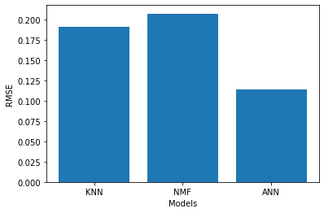
Compare the performance of collaborative-filtering models
Notes:
KNN – Maximum of 6 neighbors, msd similarity metric
NMF – 15 factors, 75 epochs
ANN – Embedding size 16, Adam Optimizer
The ANN performed substantially better. Deep learning is incredible.

Slide 22
Conclusions
A variety of techniques can be used to train recommender systems. Each technique offers its own ratio of performance and interpretability.
Familiarity with the techniques allows the analyst to pick which model for which context.
For example, a course similarity based system may be adequate for a new user with only one enrollment. While collaborative filtering methods may offer veteran accounts novel courses; keeping them interested in their membership.
Future direction for this work include deploying these models and collecting data on retention over time.

